Slide 1
Beer Case Study
Junhoi Kim

Slide 2
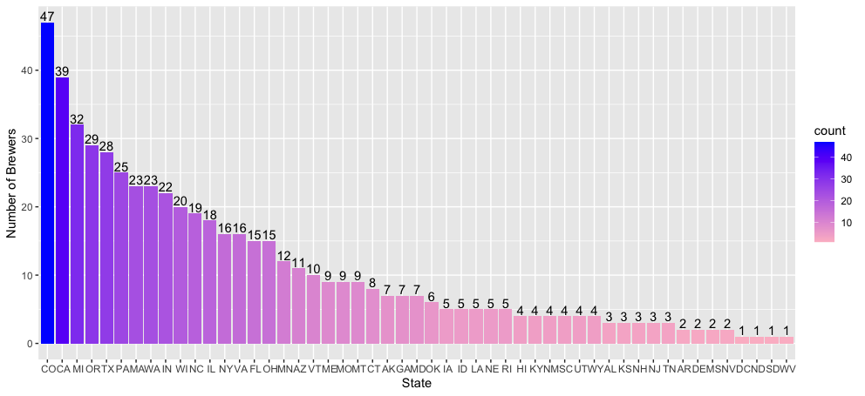
How many breweries in each state?

Slide 3
Other Exploratory Data Analysis
Discovering missing values
Identified 3% of ABV is missing (62 data points)
Identified 50% of IBU is missing (1000 data points)
Handling missing values
There is no relationship between the missing data in ABV and other attributes or values observed within the given dataset
1,000 good quality of data points are remained
Highest ABV
Without removing any missing values in ABV or IBU
With removing any missing values in ABV or IBU
Highest IBU
Regardless of missing values, Oregon has beer with the highest IBU
State | Highest ABV | Number of Beers
Colorado | 0.128 | 250
State | Highest ABV | Number of Beers
California | 0.099 | 135
State | Highest IBU | Number of Beers
Oregon | 138 | 87

Slide 4
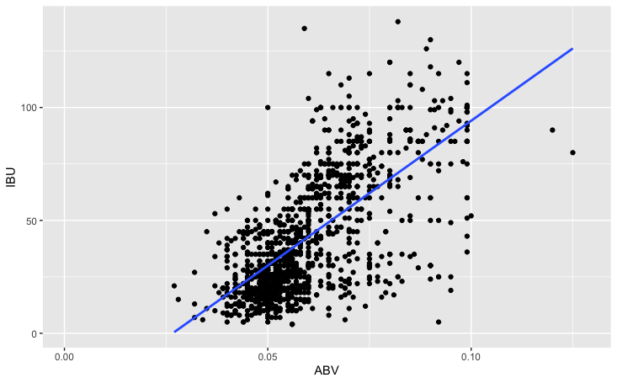
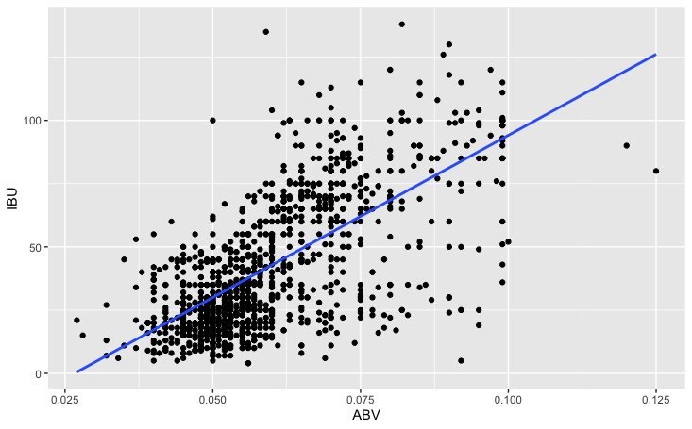
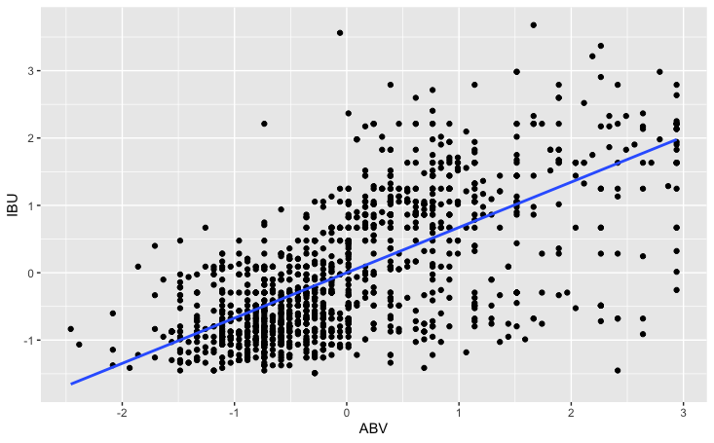
Relationship between ABV and IBU
Full Dataset
Removed NAs in ABV or IBU
Removed ABV values > 0.099 and Scale
Slope*100 | 0.0351
R-Square | 0.4493
P-value | < 2.2e-16
Slope*100 | 0.6706
R-Square | 0.4493
P-value | < 2.2e-16
Slope*100 | 0.6729
R-Square | 0.4524
P-value | < 2.2e-16
ABV and IBU have positive correlation but it shows slight increment of relationship after removing outliers and scaling ABV and IBU

